Slide 1
20.10 a pipe as IPC from signal handler Rahul shidne 006948956 CSCI 511 20.10

Slide 2
Pipes
Unix commands alone are powerful.
When we combine them together, we can accomplish complex tasks with ease.
The way we combine Unix commands is through using pipes and filters.

Slide 3
Pipes
Pipelines can be created under program control. The Unix pipe() system call asks the operating system to construct a new anonymous pipe object.
This results in two new, opened file descriptors in the process: the read-only end of the pipe, and the write-only end.
The pipe ends appear to be normal, anonymous file descriptors, except that they have no ability to seek.
To avoid deadlock and exploit parallelism, the Unix process with one or more new pipes will then, generally, call fork() to create new processes.

Slide 4
Pipes
Each process will then close the end(s) of the pipe that it will not be using before producing or consuming any data.
Alternatively, a process might create a new thread and use the pipe to communicate between them.
Named pipes may also be created using mkfifo() or mknod() and then presented as the input or output file to programs as they are invoked.
They allow multi-path pipes to be created, and are especially effective when combined with standard error redirection, or with tee.

Slide 5
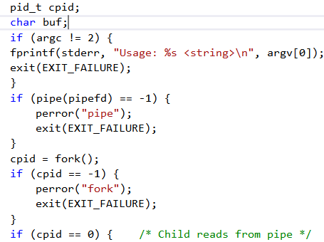
pid_t cpid;
pid_t: Used for process IDs and process group IDs.

Slide 6
Fork
It creates a new process by duplicating the calling process.
The new process, referred to as the child, is an exact duplicate of the calling process, referred to as the parent.

Slide 7
Fork
The child has its own unique process ID, and this PID does not match the ID of any existing process group.
The child's parent process ID is the same as the parent's process ID.
The child does not inherit its parent's memory locks.
Process resource utilizations and CPU time counters are reset to zero in the child.
The child's set of pending signals is initially empty.

Slide 8
Fork
The child does not inherit record locks from its parent.
The child does not inherit timers from its parent.
The child does not inherit outstanding asynchronous I/O operations from its parent.
Also it does not inherit any asynchronous I/O contexts from its parent.
The child does not inherit semaphore adjustments from its parent.

Slide 9
#include <sys/wait.h>
The <sys/wait.h> header defines the following symbolic constants for process id:
WNOHANG: Do not hang if no status is available; return immediately.
WUNTRACED: Report status of stopped child process.

Slide 10
#include <sys/wait.h>
.
The <sys/wait.h> header shall define the following macros for analysis of process status values:
WEXITSTATUS: Return exit status.
WIFCONTINUED: True if child has been continued.
WIFEXITED: True if child exited normally.
WIFSIGNALED: True if child exited due to uncaught signal.
WIFSTOPPED: True if child is currently stopped.
WSTOPSIG: Return signal number that caused process to stop.
WTERMSIG: Return signal number that caused process to terminate

Slide 11
#include <sys/wait.h>
The following symbolic constants shall be defined as possible values for
the options argument to waitid():
WEXITED: Wait for processes that have exited.
WSTOPPED: Status is returned for any child that has stopped upon
receipt of a signal.
WCONTINUED: Status is returned for any child that was stopped and
has been continued.
WNOHANG: Return immediately if there are no children to wait for.
WNOWAIT: Keep the process whose status is returned in infop in a
waitable state.

Slide 12
STDOUT_FILENO
.
The following symbolic constants shall be defined for file streams:
STDERR_FILENO: File number of stderr.
STDIN_FILENO: File number of stdin.
STDOUT_FILENO: File number of stdout.
This macro has value 1, which is the file descriptor for standard output.

Slide 13
Close(pipefd[0])
The close is used for stopping the pipe process.
It is initialized as an integer.
Pipefd[0] is used to point to an unused write end.
Close(pipefd[0]) is used to close an unused write end.

Slide 14
Close(pipefd[1])
The close is used for stopping the pipe process.
It is initialized as an integer.
Pipefd[1] is used to point to an unused read end.
Close(pipefd[0]) is used to close an read write end.

Slide 15
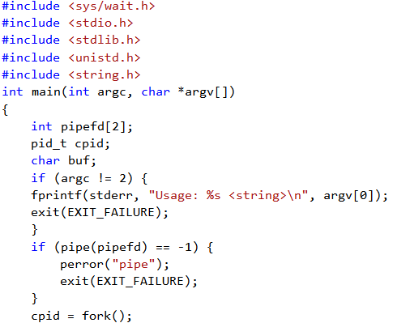
Source Code

Slide 16
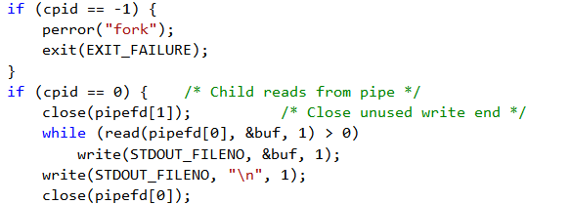
Source Code(contd..)

Slide 17
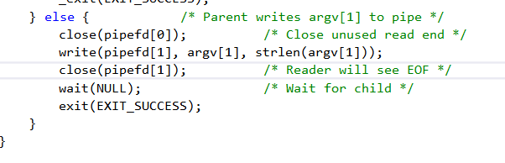
Source Code(contd..)

Slide 18
Source Code
The source code shows how the pipe is created foe unix.
If the program is run without any string it shows directly that a string is needed to execute accordingly.
The program echoes the string and creates a process to write it on the console and kills the process too.

Slide 19

Output
We compile the pipes program specifically using the c++11 standard.
We use the –o and name the output file as pipe.

Slide 20
Output
After inserting a string in front of the output file it echoes the string.
Typically in pipes we can use multiple instructions and combine
Them to form a complex statement,‘wc’ stands for word count.

